Slide 1
Unit 3
Minerals and Rocks

Slide 2
Learning Goals
List the characteristics of mineral
Summarize three ways that minerals form
Describe silicate minerals
Name common silicate minerals
Identify main classes of nonsilicate minerals
Identify physical properties that are used to identify minerals

Slide 3
Minerals
Lesson 1

Slide 4
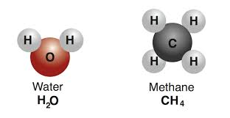
What do minerals have in common?
Mineral: naturally occurring, inorganic solid, that has a definite crystalline structure and chemical composition
Definite chemical composition
Elements
Atom
Compound
Chemical composition is determined by the element OR compound that makes up the mineral
EX: gold is an element and a mineral (Au)
EX: quartz is a compound and a mineral (SiO2)

Slide 5
Cont…
Solid
Minerals have to be solid (definite volume and shape)
Water vs ice
Inorganic- not made up of living things
Clam shells and kidney stones are made BY living things, but are still inorganic
Coal and Sugar?
NO

Slide 6
Cont…
Crystalline Structure
Crystal: solid, geometric that results from a repeating pattern of atoms or molecules
Minerals can be placed in classes based on their specific shape
Naturally Occurring
Formed by natural processes on Earth (universe)
Not synthetic (man made)
Will learn more about HOW minerals form

Slide 7
How are minerals formed?
The type of mineral that forms in a specific area depends on which elements are present in that area.
As Magma and Lava Cool
Magma (molten rock) contains most of the types of atoms that are found in minerals
As magma cools, the atoms form together to create different minerals
EX: Quartz
By Metamorphism
Temperature and pressure in Earth cause minerals to form
Bonds between atoms break and reform to make new minerals
EX: chlorite and quartz atom bonds break and reform to make garnet

Slide 8
Cont…
From Solutions
There are substances dissolved in water. As water evaporates, these substances form into solids and come out of the solution → precipitate
EX: Gypsum forms as water evaporates

Slide 9
How are minerals classified?
Based on chemical composition
Silicate
Nonsilicate
Silicate Minerals
Silicon (Si) and oxygen (O)
are the two most common elements in Earth’s crust
Minerals that contain a combination of these two elements are called silicate minerals
Most common: feldspar and quartz

Slide 10
Cont…
Nonsilicate- doesn't not contain the silicate building block
Native elements- composed of only one element (Gold, silver, lead)
Halides- form when fluorine (F) and chlorine (Cl) combine with elements (Fluorite CaF₂)
Sulfates- contain sulfur (S) and oxygen (O) (Barite BaSO₄)
Used in cosmetics, toothpaste and cement.
Carbonates- contain carbon (C) and oxygen (O) (Calcite CaCO₃)
Used in cement, building stones, and fireworks
Oxides- form when elements like aluminum (Al) or iron (Fe) combine with oxygen (O) (Corundum Al₂O₃)
Sulfides- form when elements like lead (Pb) or iron (Fe) combine with sulfur (S)

Slide 11
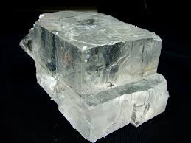
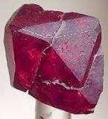
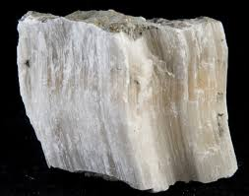
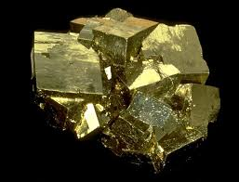
Classify that Nonsilicate
Cuprite- Cu₂O
Halite- NaCl
Gypsum- CaSO₄
Pyrite- FeS₂

Slide 12
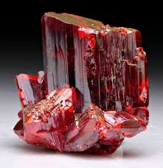
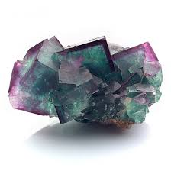
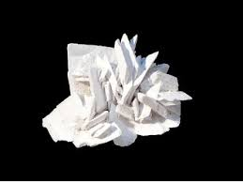
Classify that Nonsilicate
Ruby- Al₂O₃
Gold- Au
MgSO₄
Fluorite: CaF₂

Slide 13
Rocks
Lesson 2

Slide 14
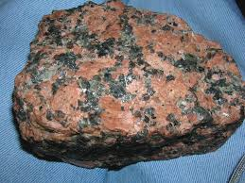
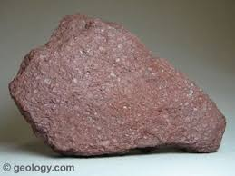
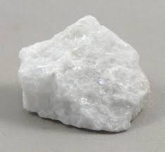
Classified
What are the classes of rocks?
Sedimentary
Igneous
Metamorphic
Sedimentary- form when minerals that form from solutions or sediment from older rocks get pressed and cemented together
Forms when the weight from above presses down on the layers of minerals and sediment pieces
Named according to size and type of fragments they contain
Sandstone, limestone
Igneous- forms when magma or lava cools and hardens to become solid
When magma cools, minerals form and grow. (contains several minerals)
Granite
Metamorphic- forms when pressures, temperature, or chemical processes change existing rock
Can be changed in 4 ways- by temp, pressure, temp and pressure, or chemical fluids
Gneiss, marble, slate

Slide 15
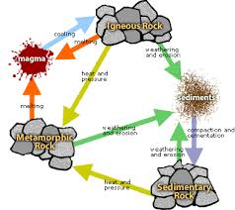
Classified Information
What is the rock cycle?
Rocks are ALWAYS changing
Each type of rock can change into the other
This series of processes is called the rock cycle
Factors that cause the rock cycle to take place are temperature, pressure, weathering, and erosion (all of these can change a rocks identity)

Slide 16
Classified
How do tectonic plate motions affect the rock cycle?
Moves rock up or down
Uplift- the rising of regions of the crust to higher elevations
Subsidence- the sinking of regions of the crust to lower elevations
By pulling apart earth’s surface
Rift zone- an area where a set of deep cracks form
Common between tectonic plates
Allows rock below Earth’s surface to rise up
Rock cools and forms igneous rock

Slide 17
Why it Matters
Describe how ancient people used rock to create shelter.
How do you think living in a rock environment affected their daily lives

Slide 18
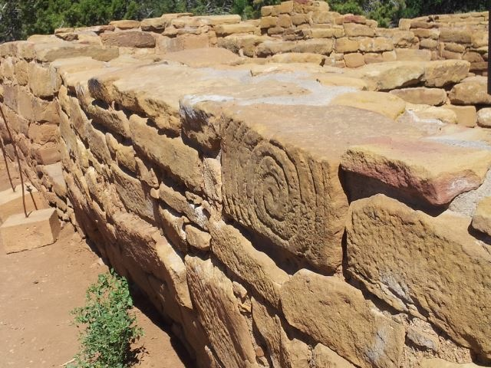
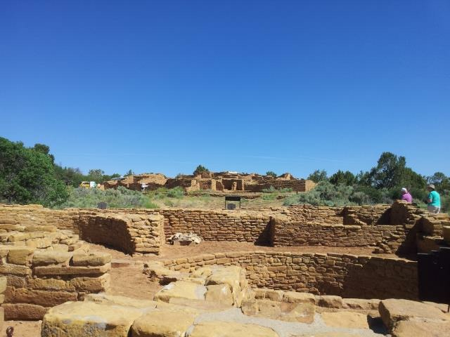
Cliff Dwellings

Slide 19
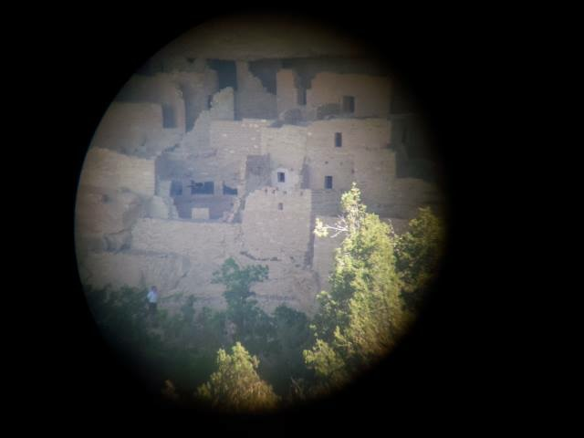

Slide 20
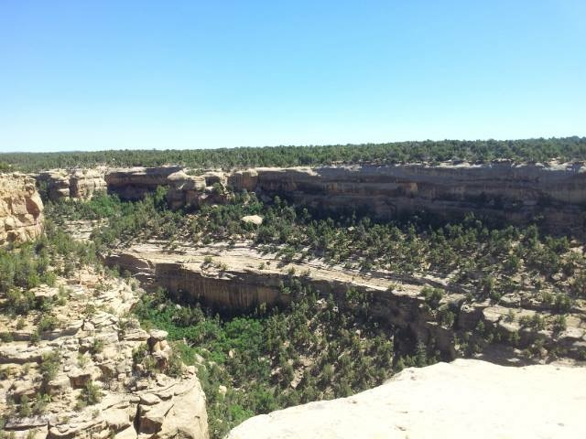

Slide 21
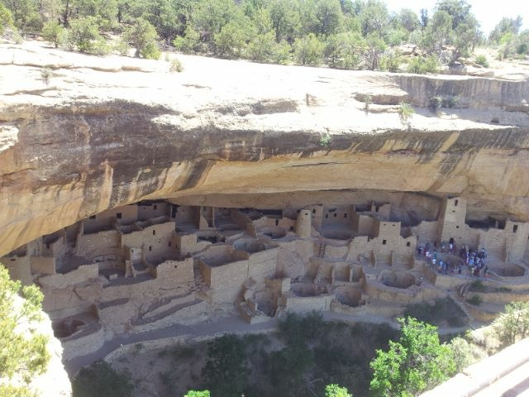

Slide 22
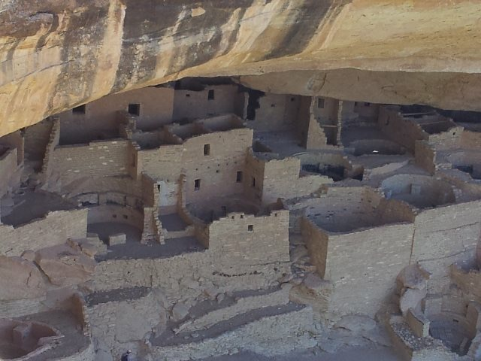

Slide 23
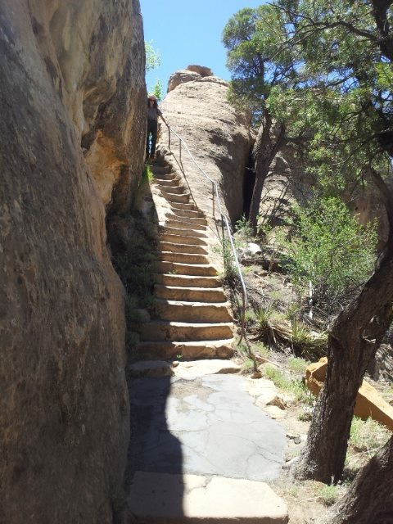

Slide 24
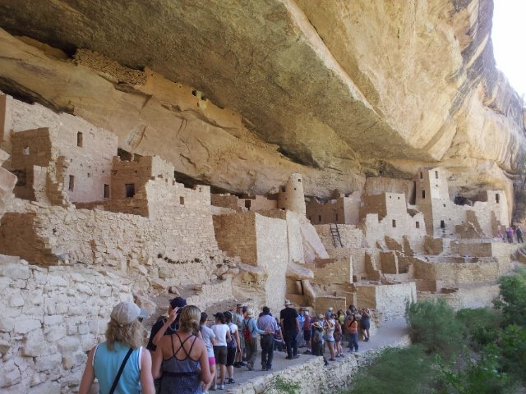

Slide 25
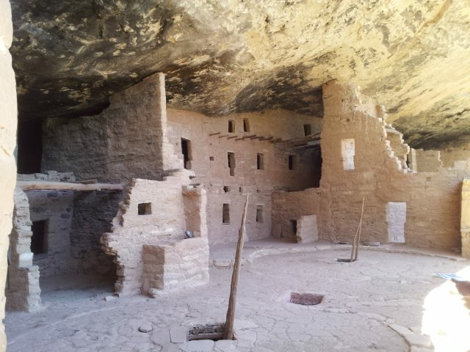

Slide 26
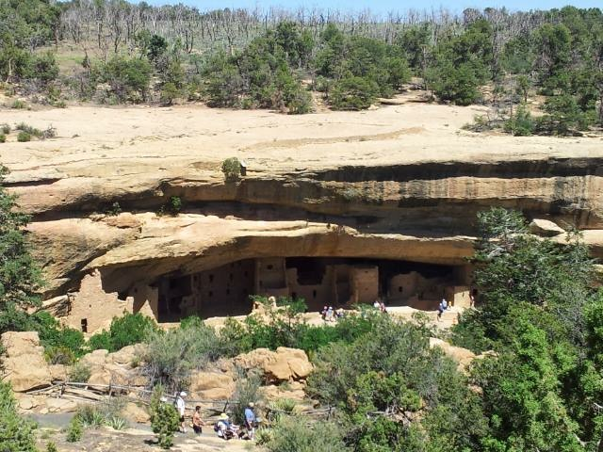

Slide 27
Three Classes of Rock
Lesson 3

Slide 28
Rock- a combination of one or more minerals or organic matter
Igneous, sedimentary, metamorphic
How are rocks classified?
By Mineral Composition
What the rock is made of (quartz, feldspar)
Silica (SiO₂)
Limestone is mostly made of the mineral, calcite
By Texture
Size, shape, positions of the grains that make up a rock
Fine-grained/coarse-grained rocks
Gives clues to how the rock was formed
Igneous- can be fine and coarse
Metamorphic- texture depends on rocks original composition and temp/pressure at which it formed
# 6, 7 pg. 173

Slide 29
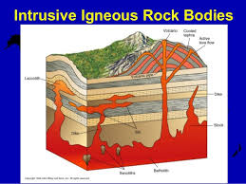
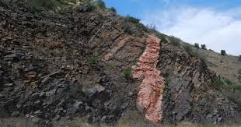
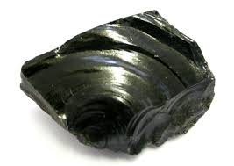
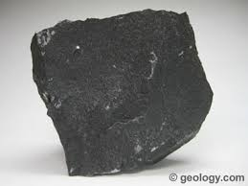
Two Kinds of Igneous Rock
Intrusive, extrusive
Intrusive- magma cools beneath Earth’s surface forming intrusive rock
Cools very slowly
Form large, visible crystals (coarse-grained)
Ex: granite, diorite
Extrusive- forms when lava erupts/extrudes onto Earth’s surface
Common around the sides and bases of volcanoes
Cools quickly, very little time for crystal formation
Fine/grained
Ex: obsidian, basalt, andesite
Rd pg 175, last para

Slide 30
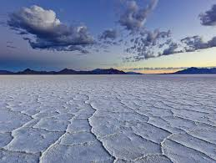
What are three types of Sedimentary Rock?
Clastic, chemical, organic
Clastic- forms when sediments are buried, compacted, and cemented together by calcite or quartz
Ex: sandstone, breccia, and conglomerate
Chemical- form when water, usually seawater, evaporates
Ex: rock salt (made of halite)
Organic- forms from the remains or fossils, or once-living plants and animals
Examples:
Limestone- from organisms that lived in the ocean
Coquina (fossiliferous limestone)
Coal- from plant material that’s been buried (takes millions of years to form

